Slide 1
OBJECT DETECTION AND PERSON TRACKING
USING YOLOv8 AND KALMAN FILTERING

Slide 2
INTRODUCTION
Objective:
To implement a real-time system that detects and continuously tracks persons in video frames using deep learning-based object detection (YOLOv8) and prediction-based tracking (Kalman Filter).
Problem Statement:
Traditional object tracking methods struggle with occlusions, missed detections, and real-time performance. A hybrid approach combining detection and predictive filtering is required for robustness

Slide 3
System Architecture
How YOLOv8 Works:
YOLOv8 is a convolutional neural network (CNN) with a backbone, neck, and head, optimized for efficiency and accuracy:
Backbone: Extracts features from the input image using a modified CSPDarknet (Cross Stage Partial Darknet) architecture. It employs techniques like C3 modules (convolutional blocks with cross-stage connections) for efficient feature extraction.
Neck: Aggregates features from different backbone layers using a Feature Pyramid Network (FPN) or Path Aggregation Network (PANet). This helps combine high-level semantic features with low-level spatial details.
Head: Predicts bounding boxes, objectness scores, and class probabilities. YOLOv8 uses an anchor-free detection head, which directly predicts object centers and sizes, improving speed and flexibility.

Slide 4
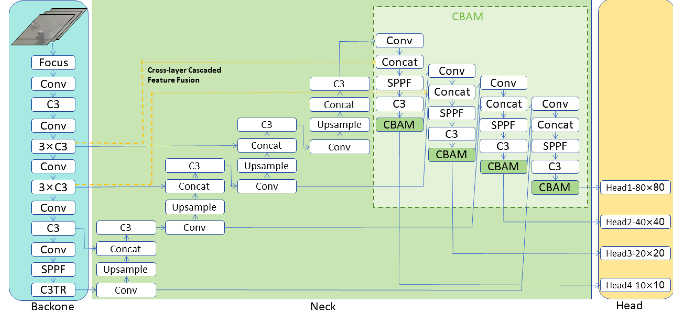
System Architecture
YOLOv8 Architecture – The 3 Main Blocks

Slide 5
Dataset Used
Class | Images | Instances
All | 853 | 2348
APC | 148 | 193
Military Truck | 82 | 131
Person | 328 | 1174
Tank | 602 | 850
For this project, we used a dataset form
Roboflow specifically tailored for military object
recognition. The dataset includes annotated
images for the following five categories:
APC (Armored Personnel Carrier)
Military Truck
Person
Tank
Dataset Details:
Total Images: [853 images]
Training Set: [e.g., 70% of data]
Validation Set: [e.g., 20% of data]
Testing Set: [e.g., 10% of data]

Slide 6
Kalman Filtering
What is a Kalman Filter?
A Kalman Filter is a mathematical algorithm used to estimate the position of a moving object over time, especially when some data is noisy or missing. It predicts where an object is expected to move in the next frame and then corrects this prediction using new detection input.
State Definition:
In our system, each object is tracked using an 8-dimensional state vector
[x,y,w,h,v_{x}​ ,v_{y}​ ,v_{w}​ ,v_{h}​]
x, y: Center of the bounding box
w, h: Width and height of the bounding box
v_{x}, v_{y​}: Velocity in x and y direction
v_{w}, v_{h}​: Change rate of width and height

Slide 7
Kalman Filtering
How it Works:
Prediction Step: The Kalman Filter uses the object's current state to predict where it will be in the next frame.
This is handled by the transition matrix, which models motion with constant velocity.
Update Step: Once YOLOv8 detects new positions of objects, these measurements are used to correct the predicted position.
The measurement matrix relates the 4 observed values [x, y, w, h] to the internal 8-state vector.
Noise Handling:
Process noise covariance accounts for uncertainty in the motion model (like unpredictable movement).
Measurement noise covariance handles errors in object detection (like false bounding box sizes).

Slide 8
Methodology
Video Frame Extraction
The input video is read frame by frame using OpenCV.
Each frame is converted to a format suitable for the YOLOv8 model (e.g., resizing, normalization).
Object Detection with YOLOv8
Every frame is passed to a pre-trained YOLOv8 model, which performs detection using three main components:
Backbone: Extracts low-level to high-level visual features.
Neck: Combines and passes features at multiple scales for better detection of small and large objects.
Head: Outputs bounding boxes, objectness scores, and class probabilities.
The model returns:
Bounding boxes: [x1, y1, x2, y2] format
Class labels: e.g., Tank, Person, APC, Military Truck
Confidence scores for each prediction
A confidence threshold (like 0.5) is applied to filter out low-confidence detections.

Slide 9
Methodology
Initializing Kalman Trackers (First Few Frames)
For every object detected in the first frame, a new Kalman Filter tracker is created.
Each tracker maintains a state vector:
[x, y, w, h, vx, vy, vw, vh]
where position, size, and velocity are stored.
The measurement matrix maps the actual detected bounding box [x, y, w, h] into this state, while the transition matrix models motion across frames.
Each tracker is given a unique ID for identification.
Detection-Tracking Matching using IoU
After prediction, new YOLOv8 detections are compared to predicted boxes using Intersection over Union (IoU):
IoU measures how much the detection overlaps with a predicted tracker box.
The detection is matched to the tracker with the highest IoU, if it's above a threshold (e.g., 0.3).
If a detection does not match any existing tracker, a new tracker is initialized.
If a tracker doesn’t get a match, it still continues to predict (helpful during occlusion or blur).

Slide 10
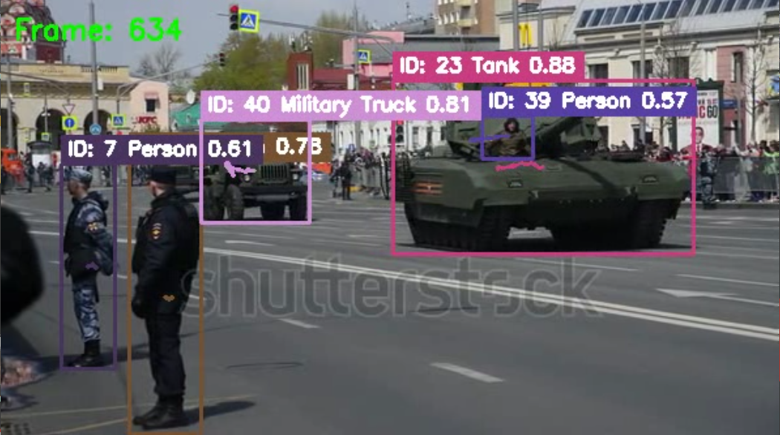
Methodology
Result Visualization
Final bounding boxes are drawn using OpenCV with:
Object Class (e.g., Tank)
Confidence score
Unique tracking ID
Each frame is either:
Displayed in real time
Or saved to disk as a new video with all detections and tracks

Slide 11
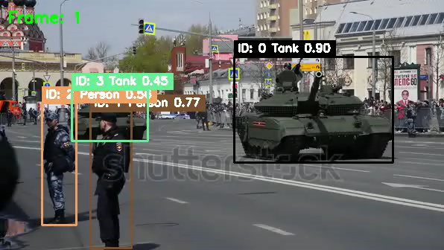
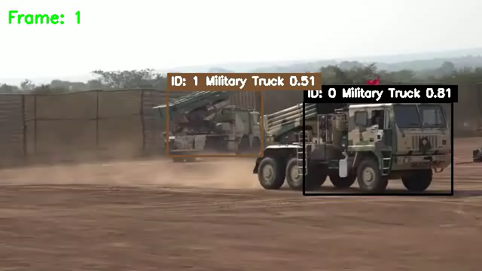
Results
Example 1
Example 2

Slide 12
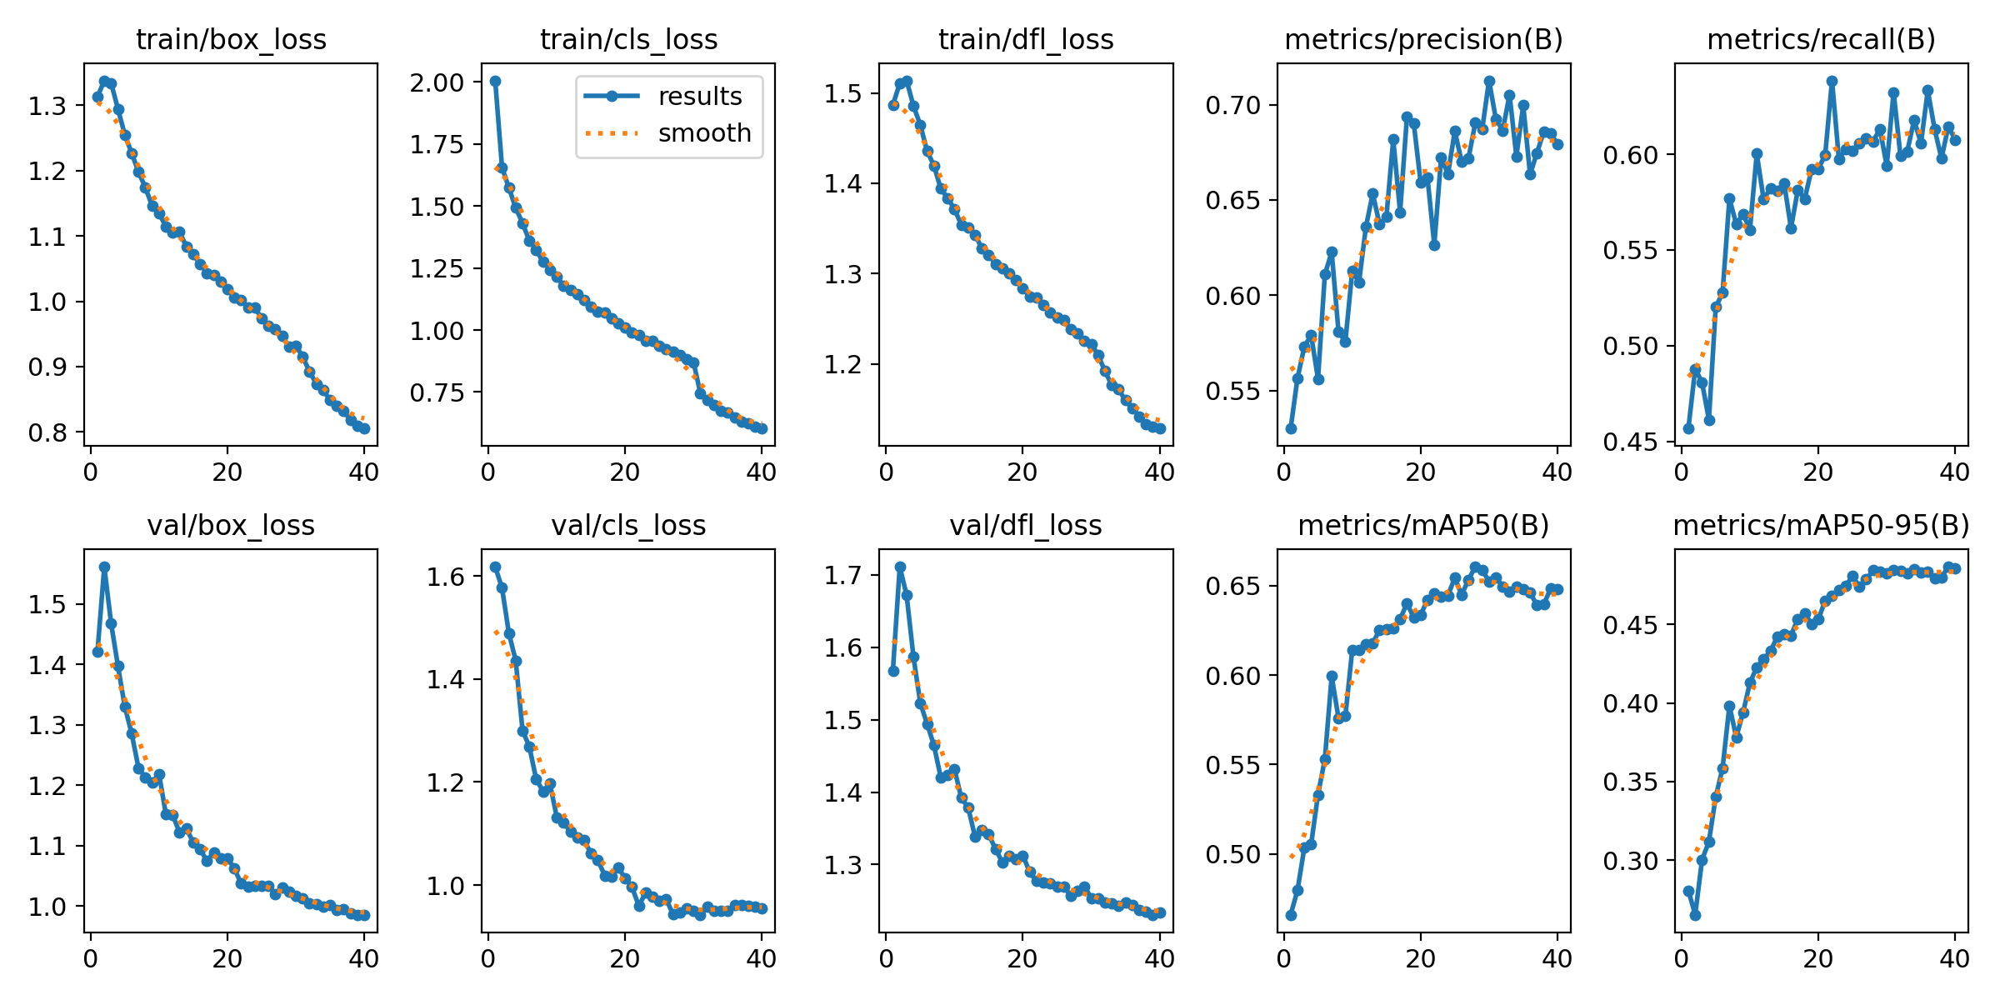
Results
Top Row
(Training Metrics)
Bottom Row
(Validation Metrics)
Train Box Loss: This refers to how accurately the model predicts the location and size of the bounding boxes during training. As training progresses (from left to right), this loss decreases, showing that the model is learning to better localize objects.
Train Classification Loss: This tells us how accurately the model classifies objects into categories like “Tank” or “Person”. A decreasing trend means the model is learning to identify object types correctly.

Slide 13
Results
Train Distance Focal Loss: This is used to improve the bounding box regression by focusing more on harder examples (badly predicted ones). It also reduces, showing improved precision in box prediction.
Precision (Training): Precision means: “Out of all the detections the model made, how many were actually correct.” It increases with time, showing the model is making fewer false detections.
Recall (Training): Recall means: “Out of all actual objects, how many did the model detect?” It also increases steadily, which is a sign the model is detecting more relevant objects.
Validation Box Loss: Same as training box loss but measured on the validation dataset. It also decreases, which is good – model is not overfitting.

Slide 14
Results
Validation Classification Loss: Indicates the classification accuracy on unseen data. A decreasing value shows the model generalizes well.
Validation Distance Focal Loss: Same concept, but again shows model performs well on unseen images too.
Mean Average Precision at 50% (Validation): This measures how well the model detects and classifies objects with an Intersection over Union threshold of 0.5. A score closer to 1.0 is better. Here, it rises above 0.6 which is decent.
Mean Average Precision at 50% to 95% (Validation): This is a stricter version that averages precision across multiple thresholds. It increases steadily, showing that the model is improving in both easy and difficult detection scenarios.

Slide 15
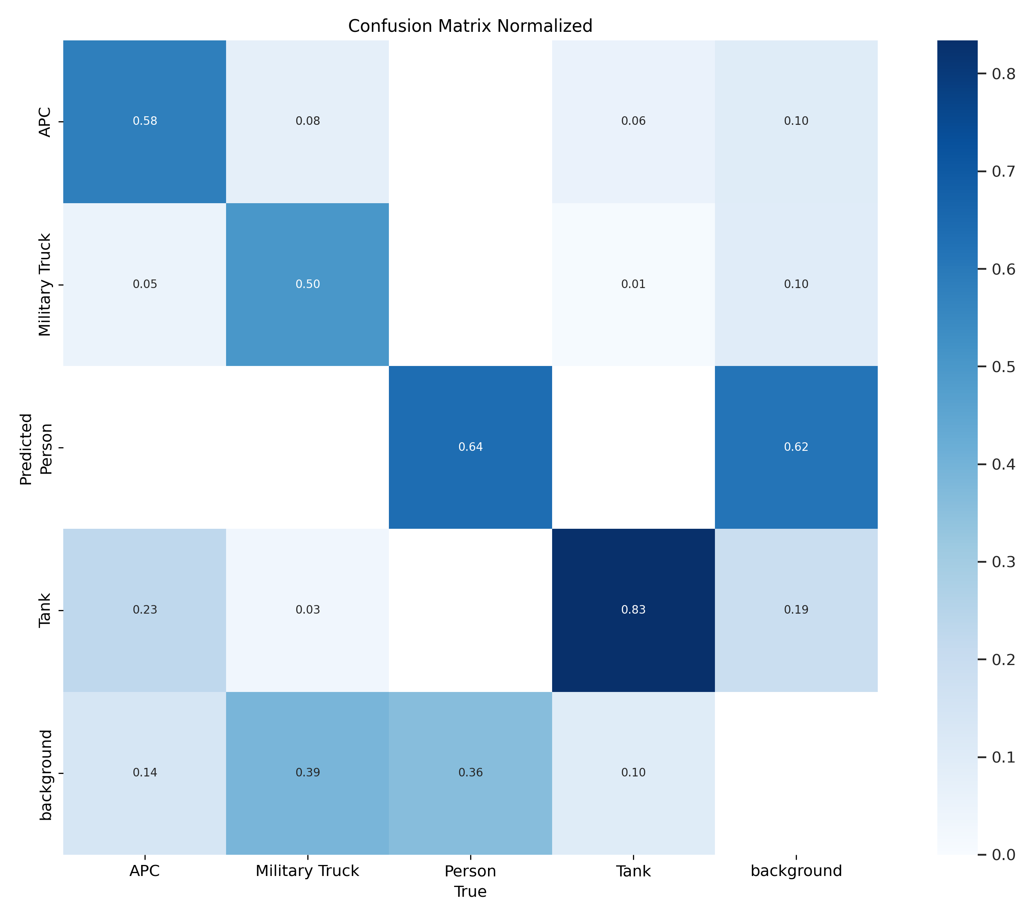
Results
This matrix helps visualize how often the
model gets each class right or wrong.
The rows show the actual (ground truth) classes, and the columns show the predicted classes.
For example:
The model correctly predicted 58% of 'APC' images as APC.
But 8% of 'APC' were misclassified as Military Truck, and 6% as Person.
It did very well with Tank, getting 83% correct, which is the highest accuracy among all classes.

Slide 16
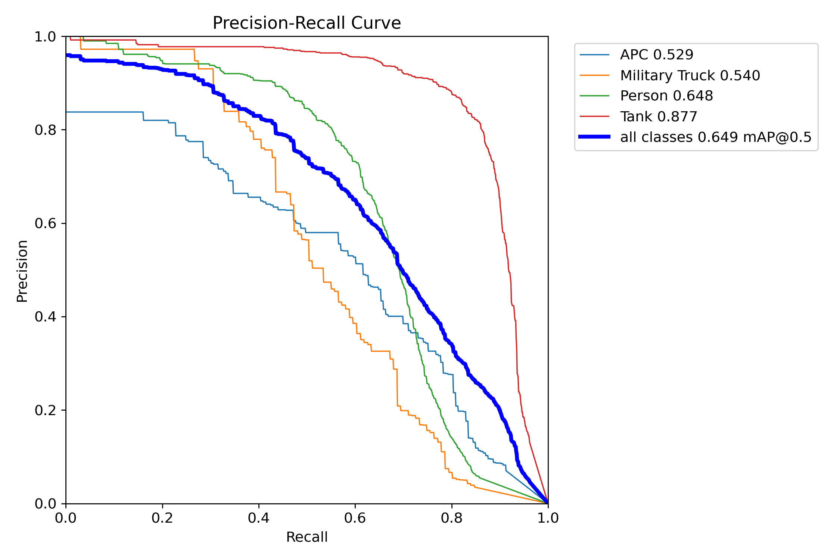
Results
This curve shows a trade-off between precision
(correctness of predictions) and recall (how
many objects were found) for each class.
The red line (Tank) is the best: it has both high precision and high recall.
Green (Person) is decent, but not as high as Tank.
Orange (Military Truck) and Blue (APC) are lower, showing these are harder for the model to distinguish.
The bold blue line represents all classes together – the mean Average Precision at 50% Intersection over Union is 0.649, which means the model performs well in general

Slide 17
CONCLUSION
In this project, we successfully implemented a real-time object detection
and person tracking system using YOLOv8 and Kalman Filtering.
YOLOv8 helped in accurately detecting multiple military-class objects in each frame.
Kalman Filter enabled smooth tracking of detected objects by predicting their motion across frames, even when detections were missed.
The system achieved a mean Average Precision (mAP@0.5) of 0.649, showing strong performance in identifying complex military objects.
It handled challenges like object overlap, motion blur, and partial occlusion using a combination of deep learning and traditional filtering techniques.

Slide 18
THANK YOU
KIRUTHIKPRANAV – CB.SC.U4AIE24023
VIKRAM - CB.SC.U4AIE24060
MANIROOP - CB.SC.U4AIE24036
SASANK GUPTA - CB.SC.U4AIE24028

